Slide 1
Advanced Modeling for Distribution Planning with OpenDSS
Instructor
Roger C. Dugan Sr. Technical Executive Sacramento, California June 22-23, 2017

Slide 2

Instructor
Roger C. Dugan, Life Fellow, IEEE
Roger is a Sr. Technical Executive with EPRI in Knoxville, Tennessee USA. He has over 45 years of combined experience in distribution engineering with EPRI, Electrotek Concepts, and Cooper Power Systems. He holds the BSEE degree from Ohio University and the Master of Engineering in Electric Power Engineering degree from Rensselaer Polytechnic Institute, Troy, NY. Roger has worked on many diverse aspects of power engineering over his career because of his interests in applying computer methods to power system simulation. Beginning with a student internship with Columbus and Southern Ohio Electric Co, his work has been focused on Distribution Engineering. He was elected a Fellow of the IEEE for his contributions in harmonics and transients analysis. Recently, he has been very active in distributed generation, particularly as it applies to utility distribution systems and distribution system analysis. He was the 2005 recipient of the IEEE Excellence in Distribution Engineering Award. He is coauthor of Electrical Power Systems Quality published by McGraw-Hill, now in its 3rd edition. He serves on the IEEE PES Distribution System Analysis Subcommittee and is active in the Distribution Test Feeders WG.

Slide 3
Faults and Voltage Sags

Slide 4
Fault Study Mode
1. Solve Snapshot, or other, power flow
2. Solve Mode=FaultStudy
Converts Generators to Dynamics mode model
Voltage behind Xd’
Computes Z_{SC} matrix at each bus
3. Show Fault
Generates Report (next slide)
Decisions to make
Do you want Load and Capacitor elements included?
Do you want to match other short circuit programs?

Slide 5
Snippet of Show Fault Report
FAULT STUDY REPORT
ALL-Node Fault Currents
Bus Node 1 X/R Node 2 X/R Node 3 X/R ... (Amps)
"SOURCEBUS", 69715045, 9999.0, 69715045, 9999.0, 69715045, 9999.0
"_MDV_SUB_1_LSB", 5290, 7.7, 5289, 7.4, 5290, 7.7
"MDV201", 5290, 7.7, 5289, 7.4, 5290, 7.7
"94743", 1534, 1.4
"94744", 1501, 1.3
"62244", 2450, 2.7
"62235", 2416, 2.6
"1144235", 1497, 2.3
"1144234", 1456, 2.2
"39754", 1527, 1.3
"MDV201_1160486ELB_INT", 1527, 1.3
"1160486", 1527, 1.3
"1160476", 1602, 1.4
"1160473", 1591, 1.4
"8163", 3310, 3.1, 3405, 3.3, 3335, 3.9
"8164", 3244, 3.1, 3342, 3.3, 3271, 3.8
"103730", 2151, 2.0
"39610", 2136, 2.0
"835", 3551, 2.6

Slide 6
Snippet of Show Fault Report
ONE-Node to ground Faults
pu Node Voltages (L-N Volts if no base)
Bus Node Amps Node 1 Node 2 Node 3 ...
"SOURCEBUS" 1 69715040 0.000 1.050 1.050
"SOURCEBUS" 2 69715038 1.050 0.000 1.050
"SOURCEBUS" 3 69715040 1.050 1.050 0.000
"_MDV_SUB_1_LSB" 1 5739 0.000 0.973 0.978
"_MDV_SUB_1_LSB" 2 5735 0.978 0.000 0.975
"_MDV_SUB_1_LSB" 3 5732 0.975 0.976 0.000
"MDV201" 1 5739 0.000 0.973 0.978
"MDV201" 2 5735 0.978 0.000 0.975
"MDV201" 3 5732 0.975 0.976 0.000
"94743" 1 1534 0.000
"94744" 1 1501 0.000
"1160473" 2 1591 0.000
"8163" 1 2797 0.000 1.068 1.115
"8163" 2 2795 1.129 0.000 1.071
"8163" 3 2783 1.046 1.128 0.000
"8164" 1 2724 0.000 1.072 1.116
"8164" 2 2723 1.132 0.000 1.075
"8164" 3 2712 1.049 1.131 0.000

Slide 7
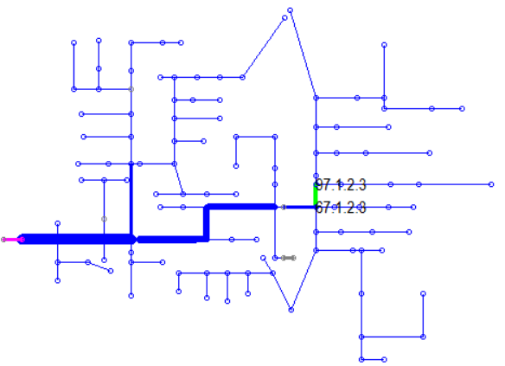
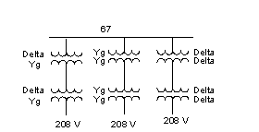
Monte Carlo Fault Study Example – Voltage Sags at End User Facility
IEEE 123-Bus Test Feeder

Slide 8
Transformer Definition Scripts
// make bus 67 the test bus
// define different kinds of transformers there
// inverters assumed connected to 208-V side
New Transformer.DY phases=3 windings=2 Buses=[67 67DY] conns=[Delta wye] kVs=[4160 208] kVAs=[500 500]
New Transformer.YY phases=3 windings=2 Buses=[67 67YY] conns=[wye wye] kVs=[4160 208] kVAs=[500 500]
New Transformer.DD phases=3 windings=2 Buses=[67 67DD] conns=[Delta Delta] kVs=[4160 208] kVAs=[500 500]
// now add D-Y metering transformer for monitors.
// L-N voltages on Y side represent L-L voltages on primary
New Transformer.DYBus phases=3 windings=2 Buses=[67DY DYBus] conns=[Delta wye] kVs=[208 208] kVAs=[500 500]
New Transformer.YYBus phases=3 windings=2 Buses=[67YY YYBus] conns=[wye wye] kVs=[208 208] kVAs=[500 500]
New Transformer.DDBus phases=3 windings=2 Buses=[67DD DDBus] conns=[Delta wye] kVs=[208 208] kVAs=[500 500]

Slide 9
Add some Monitors and Solve Monte Carlo Fault Mode (MF mode)
// Monitors
New Monitor.DY Transformer.DYBus 2
New Monitor.YY Transformer.YYBus 2
New Monitor.DD Transformer.DDBus 2
Solve mode=MF Number=1000

Slide 10
Define a SLG Fault at every Node
New Fault.150_1 Phases=1 Bus1=150.1
New Fault.150_2 Phases=1 Bus1=150.2
New Fault.150_3 Phases=1 Bus1=150.3
New Fault.150r_1 Phases=1 Bus1=150r.1
New Fault.150r_2 Phases=1 Bus1=150r.2
New Fault.150r_3 Phases=1 Bus1=150r.3
New Fault.149_1 Phases=1 Bus1=149.1
New Fault.149_2 Phases=1 Bus1=149.2
New Fault.149_3 Phases=1 Bus1=149.3
New Fault.1_1 Phases=1 Bus1=1.1
New Fault.1_2 Phases=1 Bus1=1.2
New Fault.1_3 Phases=1 Bus1=1.3
New Fault.2_2 Phases=1 Bus1=2.2
New Fault.3_3 Phases=1 Bus1=3.3
New Fault.7_1 Phases=1 Bus1=7.1
New Fault.7_2 Phases=1 Bus1=7.2
New Fault.7_3 Phases=1 Bus1=7.3
New Fault.4_3 Phases=1 Bus1=4.3
New Fault.5_3 Phases=1 Bus1=5.3
New Fault.6_3 Phases=1 Bus1=6.3
New Fault.8_1 Phases=1 Bus1=8.1
New Fault.8_2 Phases=1 Bus1=8.2
New Fault.8_3 Phases=1 Bus1=8.3
<Snip>
A capable Text Editor such as Editplus or Notepad++ helps with developing this script

Slide 11
Monte Carlo Fault Mode
MF Mode disables all faults to start
For each solution of Solve Mode=MF Number=1000
Randomly picks a Fault object and Enables it
Randomly sets the Fault R
Perform a direct mode solution
I = YV
Non-iterative
Sample Monitors
Results come fast, so having Monitors is a must
Note: When this is done, OpenDSS is still in MF mode. Set Mode=Snapshot to return to power flow mode

Slide 12
Show Monitor DY
hour, t(sec), V1, VAngle1, V2, VAngle2, V3, VAngle3, V4, VAngle4, I1, IAngle1, I2, IAngle2, I3, IAngle3, I4, IAngle4
1, 0.00000, 108.327, -62.4298, 120.399, -179.392, 120.016, 54.1703, 0, 0, 1.73472E-018, -90, 0, 0, 3.46945E-018, 0, 3.87896E-018, 153.435
2, 0.00000, 120.888, -66.5866, 109.152, 177.505, 122.463, 60.1185, 0, 0, 0, 0, 1.19262E-018, 0, 0, 0, 0, 0
3, 0.00000, 115.249, -51.6439, 114.458, 166.388, 74.8487, 57.9442, 0, 0, 2.45327E-018, -135, 1.30104E-018, 0, 1.73472E-018, 0, 1.73472E-018, 90
4, 0.00000, 118.426, -71.638, 86.6222, 175.047, 115.793, 64.9693, 0, 0, 0, 0, 1.74822E-018, 82.875, 3.46945E-018, 0, 3.87896E-018, -153.435
5, 0.00000, 96.3678, -64.4554, 115.656, -177.096, 118.667, 51.4507, 0, 0, 8.67362E-019, 90, 4.33681E-019, 180, 0, 0, 1.73472E-018, 90
6, 0.00000, 114.817, -51.6803, 114.95, 166.367, 74.8954, 57.247, 0, 0, 2.45327E-018, -135, 0, 0, 2.45327E-018, 45, 1.73472E-018, -90
7, 0.00000, 120.553, -58.0565, 120.552, 174.013, 105.825, 57.9791, 0, 0, 0, 0, 2.1684E-019, 0, 1.73472E-018, 180, 1.73472E-018, 0
8, 0.00000, 118.669, -69.3211, 98.6521, 177.514, 120.847, 62.0432, 0, 0, 3.87896E-018, -153.435, 2.1684E-019, 0, 1.73472E-018, 90, 3.46945E-018, 0
9, 0.00000, 114.627, -76.5338, 73.4889, 177.969, 118.484, 66.7613, 0, 0, 3.46945E-018, 180, 1.89348E-018, -66.3706, 3.57622E-018, 165.964, 3.46945E-018,
10, 0.00000, 118.954, -55.7423, 117.467, 170.341, 92.5454, 58.1466, 0, 0, 1.73472E-018, 180, 3.57622E-018, 75.9638, 1.93948E-018, -153.435, 2.45327E-018,
11, 0.00000, 119.703, -57.2601, 119.811, 173.476, 102.616, 58.0537, 0, 0, 3.46945E-018, 90, 4.33681E-019, 0, 1.73472E-018, 180, 1.73472E-018, -90
12, 0.00000, 119.812, -56.9032, 118.978, 171.589, 98.0646, 57.7873, 0, 0, 3.46945E-018, -90, 1.0842E-018, 0, 0, 0, 2.45327E-018, 45
13, 0.00000, 98.679, -62.2447, 118.255, -177.238, 117.733, 52.1978, 0, 0, 1.73472E-018, -90, 3.46945E-018, 90, 0, 0, 3.46945E-018, 0
14, 0.00000, 91.3364, -62.2952, 116.543, -175.468, 116.392, 50.7038, 0, 0, 8.67362E-019, -90, 4.33681E-019, 180, 1.73472E-018, 0, 3.46945E-018, 180
15, 0.00000, 114.502, -56.6307, 121.54, 169.908, 93.4741, 52.6728, 0, 0, 1.73472E-018, 180, 4.33681E-019, 180, 1.73472E-018, 0, 3.46945E-018, -90
16, 0.00000, 107.748, -62.294, 120.436, -179.287, 119.727, 54.0255, 0, 0, 2.45327E-018, 135, 8.67362E-019, 0, 0, 0, 1.73472E-018, 90
17, 0.00000, 94.5129, -62.4402, 117.161, -176.206, 117.194, 51.3619, 0, 0, 0, 0, 1.30104E-018, 0, 0, 0, 1.73472E-018, -90
18, 0.00000, 114.367, -76.6648, 73.2933, 178.119, 118.539, 66.7065, 0, 0, 3.46945E-018, 0, 3.63491E-018, -107.354, 3.57622E-018, 165.964, 1.73472E-018, 90
19, 0.00000, 86.8977, -62.5884, 115.08, -174.484, 115.482, 49.7983, 0, 0, 3.57622E-018, 165.964, 4.33681E-019, 180, 1.73472E-018, -90, 1.73472E-018, 0
20, 0.00000, 72.9831, -62.7321, 112.679, -171.05, 113.375, 46.6202, 0, 0, 3.57622E-018, 14.0362, 0, 0, 1.73472E-018, -90, 1.73472E-018, 180
Copy and Paste into Excel
Ctrl-A, Ctrl-C, (Excel) Ctrl-V

Slide 13
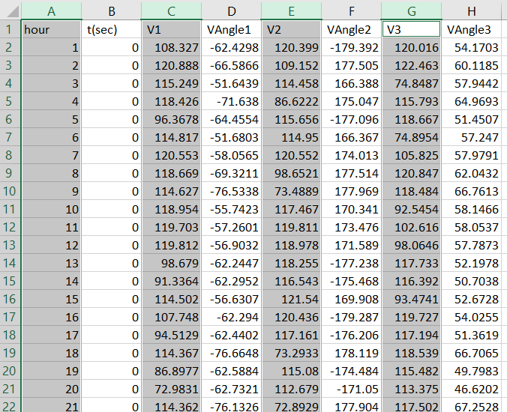
In Excel … Select Voltage Magnitudes

Slide 14
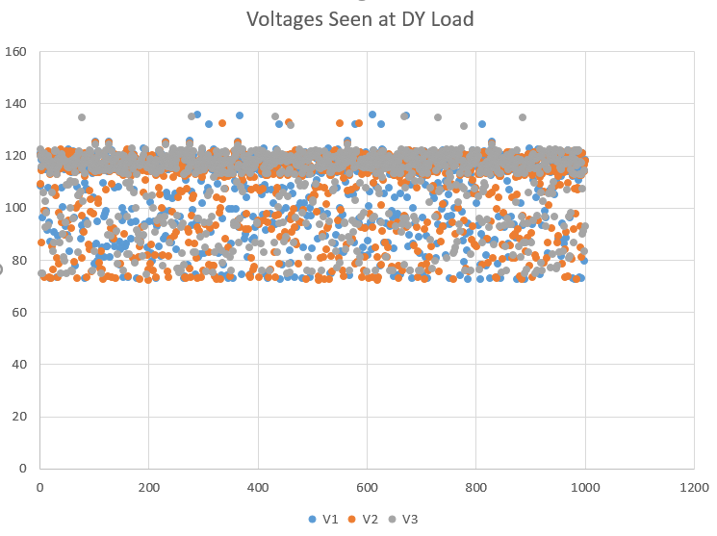
Insert Scatter Plot … DY Load

Slide 15
Histogram … DY

Slide 16
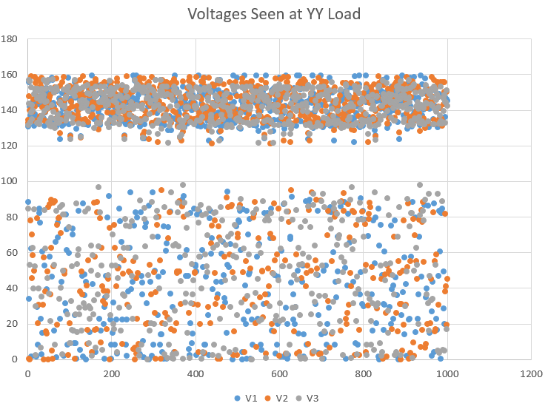
Insert Scatter Plot … YY Load

Slide 17
Histogram … YY

